Slide 1


“Information Security”
Lecture # 1
Dr. Engr. M Malook Rind
Ph.D (I.T), ME (CSN), MBA (MIS), BE (CS)
CCNA, CCNP, Juniper Certified.
Professor (Computer Science)

Slide 2
Contents
Tutor and Student Introduction
Course Introduction
Information Security Fundamentals
Dr. M Malook Rind Information Security Lecture 1

Slide 3
Tutor’s Introduction
Dr. M Malook Rind Information Security Lecture 1

Slide 4
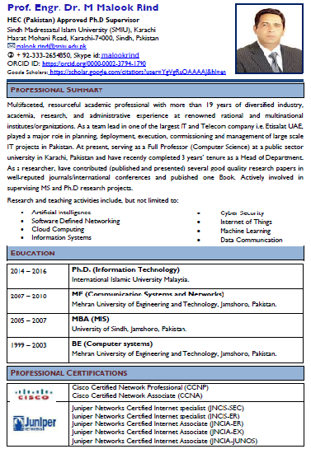
Dr. M Malook Rind Information Security Lecture 1

Slide 5
Students’ Introduction
Dr. M Malook Rind Information Security Lecture 1

Slide 6
Course Introduction
Course Code
CSC302
Course Title
Information Security
Credit Hours
3
Prerequisites
None
Dr. M Malook Rind Information Security Lecture 1

Slide 7
Course Introduction (Cont…)
Evaluation criteria:
Course work Evaluation Distribution | Marks Distribution
Quizzes | 10 (4 Quizzes)
Assignment | 10 (4 Assignments)
Class Participation/ Project Presentation | 5 Participation 15 (4 Members Presentation)
Mid Term Exam | 20
Final Term Exam | 40
Total | 100
Dr. M Malook Rind Information Security Lecture 1

Slide 8
Course Introduction (Cont…)
Course Summary
This course provides a broad overview of the threats to the security of information systems, the responsibilities and basic tools for information security, and the levels of training and expertise needed in organizations to reach and maintain a state of acceptable security. It covers concepts and applications of system and data security. This course covers information security principles, an area of study that engages in protecting the confidentiality, integrity, and availability of information. The course is designed to demonstrate the modes of threats and attacks on data, information, networks and information systems. Moreover, the basic access control models and the fundamentals of identification and authentication methods are included in this course.
Dr. M Malook Rind Information Security Lecture 1

Slide 9
Course Introduction (Cont…)
Course Contents
• Introduction to Information Security: The History and Evolution of Information Security, Confidentiality, Integrity, and Availability – The CIA Triad, Threats, Vulnerabilities, and Risks, The Risk Management Process, The Incident Response Process, Security Control.
• Threats and Attack Modes: Threat Terminology, Types of Attacks; Spoofing Attacks; Social Engineering Attacks, Application Attacks; Web Application Attacks, Malware attacks, Denial of Service (DoS) and Distributed Denail of Service (DDoS).
• Cryptographic Models: Cryptographic History, The Caesar Cipher, Goals of Cryptography, Comparing Cryptographic Algorithm, Symmetric Key Algorithms, Asymmetric Key Algorithms, Hashing Algorithms, Types of Key Algorithms.
• Access Control: Access Control Terminology, Access Control Models.
• Identification and Authentication: Identification, Authentication Types, Human Authentication Factors, Authentication Forms, Authentication Protocols, Single Sign-On (SSO), Public-Key Infrastructure (PKI).
Dr. M Malook Rind Information Security Lecture 1

Slide 10
Course Introduction (Cont…)
Course Contents
• Network Security: Network Security Design, Firewalls, Network Protection, Web Security. Wireless Network Security, Cloud And Virtualization Security, IOT Security
• Operating System (OS) Security: OS Hardening, OS Protection Methods, OS Firewalls, OS Security Tools.
• Intrusion Detection and Prevention Systems: Intrusion Detection Systems (IDS), Network Intrusion Detection Systems (NIDS), Host-based Intrusion Detection Systems (HIDS), Intrusion Prevention Systems (IPS), System Information and Event Management (SIEM).
• Privacy Laws: Penalties, and Privacy Issues, Electronic Data Privacy Protection, Global Privacy Laws.
Dr. M Malook Rind Information Security Lecture 1

Slide 11
Course Introduction (Cont…)
Learning Outcomes
At the end of this course, a student should understand the:
Explain key concepts of information security such as design principles, cryptography, risk management, and ethics.
Discuss legal, ethical, and professional issues in information Security.
Apply various security and risk management tools for achieving information security and privacy.
Identify appropriate techniques to tackle and solve problems in the discipline of information security.
Dr. M Malook Rind Information Security Lecture 1

Slide 12
Course Introduction (Cont…)
Learning Strategies
Active learning strategies are employed in this course to encourage students' participation in class and to foster their abilities to gather information and data from its sources and analyze it.
Active learning strategies will focus on Theory, Problem Analysis, Design and/or Solution and Social Ethical Issues related to Computer Science in general and course in particular.
Active learning strategies include assignments/projects where students work in individual and in teams to solve certain problems and do projects on their own. Readings may include many Internet sites
Dr. M Malook Rind Information Security Lecture 1

Slide 13
Course Introduction (Cont…)
Books and Resources:
1. Computer Security: Principles and Practice, 5th edition by William Stallings
2. Principles of Information Security, 7th edition by M. Whitman and H. Mattord
3. Computer Security Fundamentals, 3rd edition by William Easttom
4. Comptia Security+ Guide to Network Security Fundamentals 7 Edition by Mark Ciampa
5. The Official (ISC)2 CISSP CBK Reference 6th Edition by Arthur J. Deane, Aaron Kraus
6. Ethical Hacking Essentials (Professional) 1st Edition by EC-Council 2021
Dr. M Malook Rind Information Security Lecture 1

Slide 14
Why Study this subject?
Course Introduction (Cont…)
The study of Information Security teach you how to protect computer operating systems, networks, and data from cyber attacks. You’ll learn how to monitor systems and mitigate threats when they happen.
Reasons to Learn Information/Cybersecurity
High Demand
Plenty of Opportunities
Specialties within cyber security are increasing
Great Salary Benefits
Working with Top Organizations
A Job that Never Gets Boring
A Variety of Industries to Choose
Dr. M Malook Rind Information Security Lecture 1

Slide 15
Why Study this subject?
Course Introduction (Cont…)
Few sub domains or specialized area include:
Network security
Infrastructure security
Application security
Cloud computing security
Internet security
The sorts of roles that you could fulfil may include:
Information security analyst
Digital forensic examiner
Security systems administrator
IT security specialist
Security engineer
Security architect
Chief information officer (CIO)
Chief information Security Officer (CISO)
Network security engineer
Cybersecurity manager
Security Technician
Dr. M Malook Rind Information Security Lecture 1

Slide 16
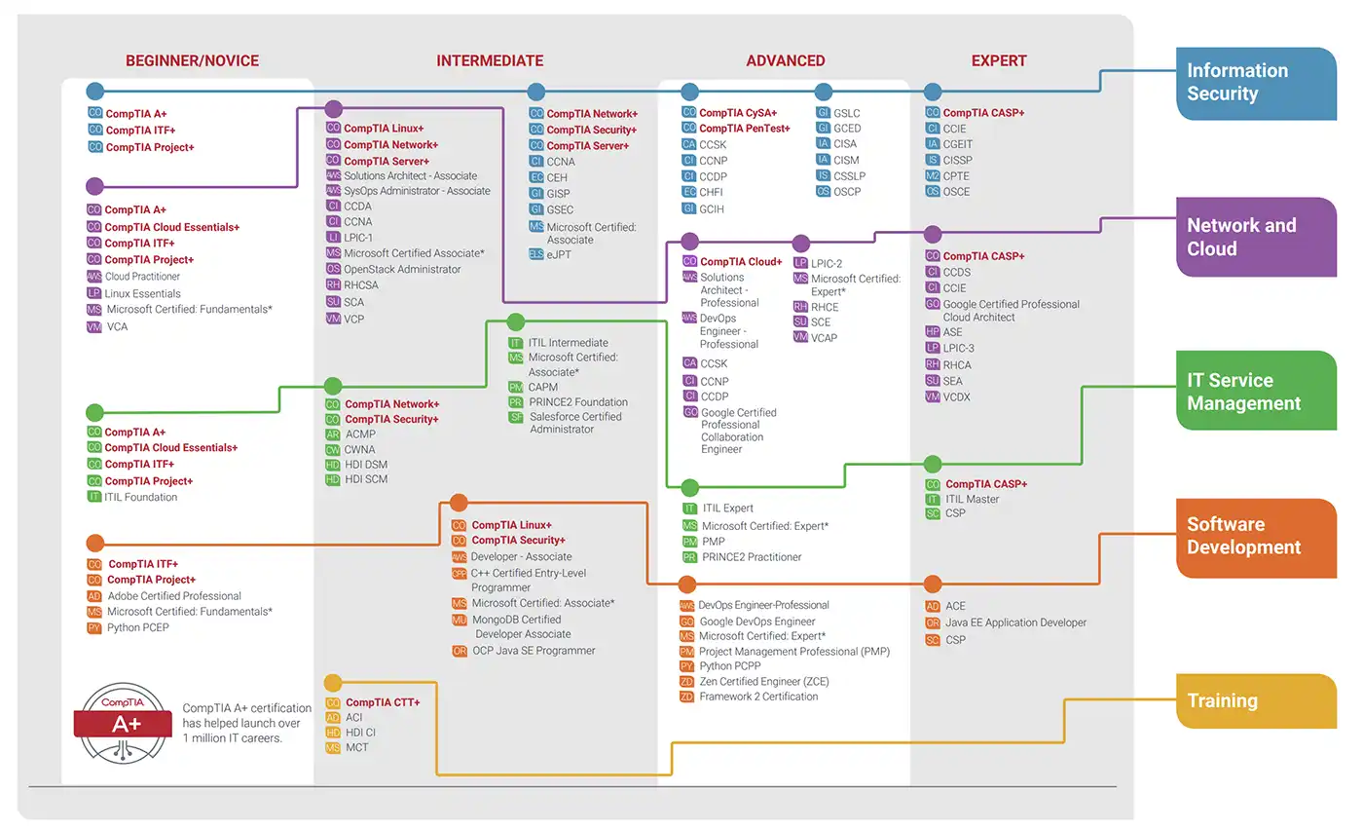
Certifications in Cyber/Information Security
Course Introduction (Cont…)
Dr. M Malook Rind Information Security Lecture 1

Slide 17
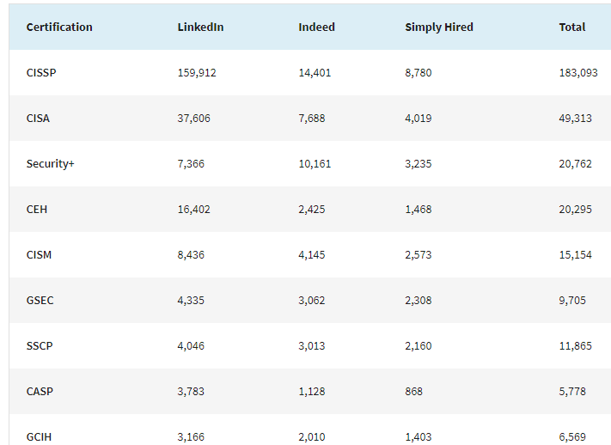
In Demand Certifications world wide 2023
Course Introduction (Cont…)
Dr. M Malook Rind Information Security Lecture 1

Slide 18
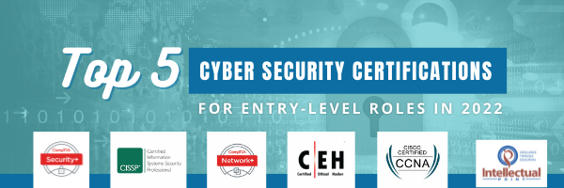
Entry Level Cyber Security Certifications
Course Introduction (Cont…)
Dr. M Malook Rind Information Security Lecture 1

Slide 19

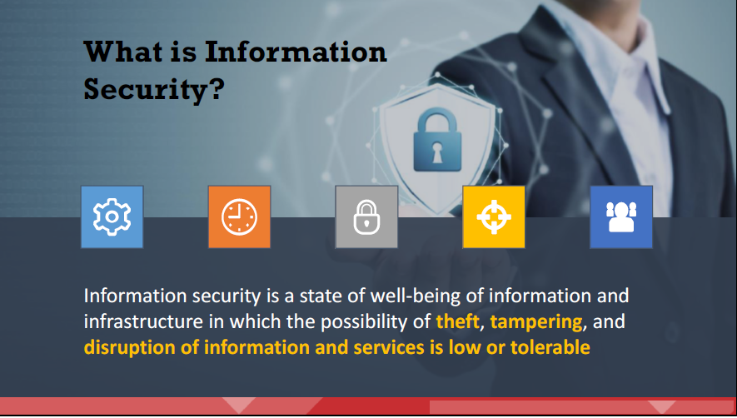
Information Security - Overview
Information security refers to the protection or safeguarding of information and information systems that use, store, and transmit information from unauthorized access, disclosure, alteration, and destruction.
Dr. M Malook Rind Information Security Lecture 1

Slide 20
Information Security - Overview
Information security (InfoSec) is a set of tools and practices that you can use to protect your digital and analog information. InfoSec covers a range of IT domains, including infrastructure and network security, auditing, and testing. It uses tools like authentication and permissions to restrict unauthorized users from accessing private information.
Organizations implement information security for a wide range of reasons. The main objectives of InfoSec are typically related to ensuring confidentiality, integrity, and availability of company information.
InfoSec covers various types of security, including application security, infrastructure security, cryptography, incident response, vulnerability management, and disaster recovery.
Dr. M Malook Rind Information Security Lecture 1

Slide 21
Difference between Cyber Security and Information Security
The terms Cyber Security and Information Security are often used interchangeably. Information security is a broader category of protections.
The National Institute of Standards and Technology (NIST) recognizes information security and cybersecurity as separate career areas. That said, there is certainly an overlap between the two.
Information security is an overarching term for creating and maintaining systems and policies to protect any information—digital, physical or intellectual, not just data in cyberspace. Information security is a practice organizations use to keep their sensitive data safe.
Cybersecurity, on the other hand, protects both raw and meaningful data, but only from internet-based threats. Cybersecurity is a practice organizations use to protect their vulnerable technology.
Dr. M Malook Rind Information Security Lecture 1

Slide 22
The Information Security Workforce
Divided into two broad categories
The Information security managerial personnel: administer and manage plans, policies, and people
The Information security technical personnel: concerned with designing, configuring, installing, and maintaining technical security equipment.
These two broad categories are four generally recognized types security positions
Chief information security officer (CISO). This person reports directly to the chief information officer (CIO) and is responsible for assessing, managing, and implementing security.
Security manager. The security manager reports to the CISO and supervises technicians, administrators, and security staff. Typically, a security manager works on tasks identified by the CISO and resolves issues identified by technicians. This position requires an understanding of configuration and operation but not necessarily technical mastery.
Security administrator. The security administrator has both technical knowledge and managerial skills. A security administrator manages daily operations of security technology and may analyze and design security solutions within a specific entity as well as identifying users’ needs.
Security technician. This position is generally entry level for a person who has the necessary technical skills. Technicians provide technical support to configure security hardware, implement security software, and diagnose and troubleshoot problems.
Dr. M Malook Rind Information Security Lecture 1

Slide 23
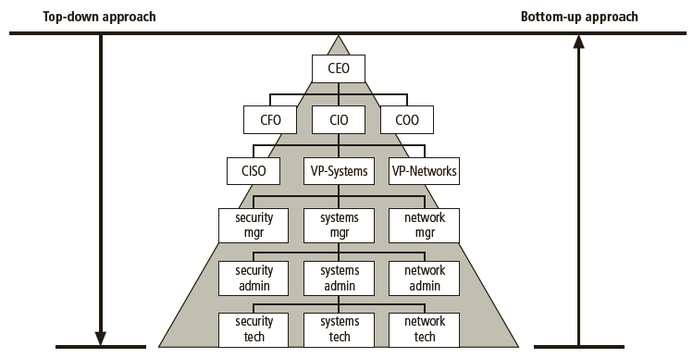
The Information Security Workforce
Approaches to information security Workforce implementation
Bottom-up Approach: A method of establishing security policies and/or practices that begins as a grassroots effort in which systems administrators attempt to improve the security of their systems.
Top-down Approach: A methodology of establishing security policies and/or practices that is initiated by upper management.
Dr. M Malook Rind Information Security Lecture 1

Slide 24
The History and Evolution of Information Security
1950s -1960s
Information Security or InfoSec doesn't exist in the 1950s or even in the 1960s.
Security is all about physically securing access to expensive machines.
1970s
There's a shift from computer security towards information security.
ARPANET, the US Department of Defense published a study (Ware Report) on Security Controls for Computer Systems.
James P. Anderson authors Computer Security Technology Planning Study for the USAF in 1972.
In 1973, researchers at MIT look at the security aspects of Multics (OS) and come up with three categories security design principles: unauthorized release, unauthorized modification, unauthorized denial.
1980s
Confidentiality and Integrity concepts of data emerged.
In 1988 Morris Worm becomes the first DoS attack on the Internet. Thus, Availability is recognized as an essential aspect of information security.
In 1989 NASA Information Security Plan document uses the term CIA Triad.
Dr. M Malook Rind Information Security Lecture 1

Slide 25
The History and Evolution of Information Security
1990s
In 1998 Information Information Assurance (IA) emerges as a discipline. This is more about securing information systems rather than information alone.
With the growth of networks and Internet, Non – Repudiation and Authentication become important concerns.
computer viruses and worms began to appear, causing significant damage to computer systems.
2000s
Cyber attacks and hacking became more sophisticated and targeted with the proliferation of WWW. This led to the development of more advanced security measures such as encryption, multi-factor authentication, and virtual private networks (VPNs). The rise of cloud computing and mobile devices also introduced new security challenges.
All new forms of cyber attacks emerged on individuals, organizations and Government.
The Present Day and Future
Cloud Computing and Internet of Things (IoT) have introduced new security challenges.
Artificial intelligence, Machine Learning and Quantum Computing have become more advanced to play an increasingly important role in detecting and responding to cyber threats.
Dr. M Malook Rind Information Security Lecture 1

Slide 26
The need for Information security:
Information security is essential for protecting sensitive and valuable data from unauthorized access, use, disclosure, disruption, modification, or destruction.
Importance of Information Security for Organizations:
Protecting Confidential Information
Complying with Regulations
Maintaining Business Continuity
Protecting Customer Trust
Preventing Cyber-attacks
Protecting Employee Information
Importance of Information Security for Organizations:
Protecting Personal Data:
Maintaining Online Privacy
Securing Online Transactions
Dr. M Malook Rind Information Security Lecture 1

Slide 27
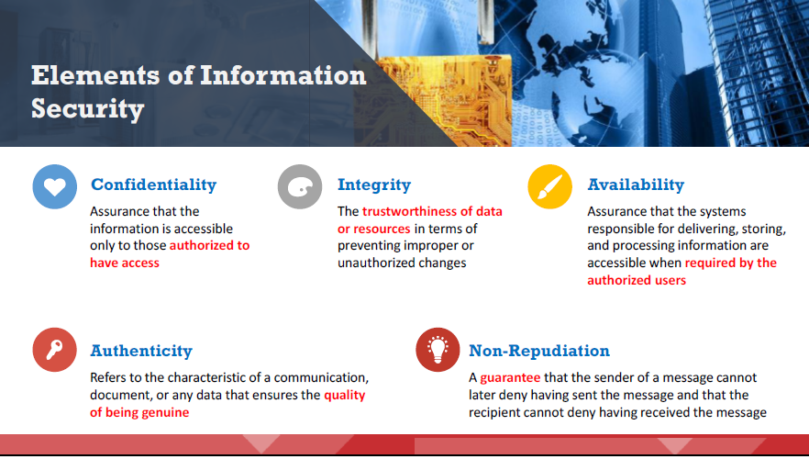
Elements of Information Security
Information security relies on five major elements:
Dr. M Malook Rind Information Security Lecture 1

Slide 28
Thanks
Dr. M Malook Rind Information Security Lecture 1

